Slide 1
Borghesi Horizontal Laser Positioning

Slide 2
Aims
Read the interferometer data using MATLAB
Identify the least warped section of the foil
Output its relative position

Slide 3
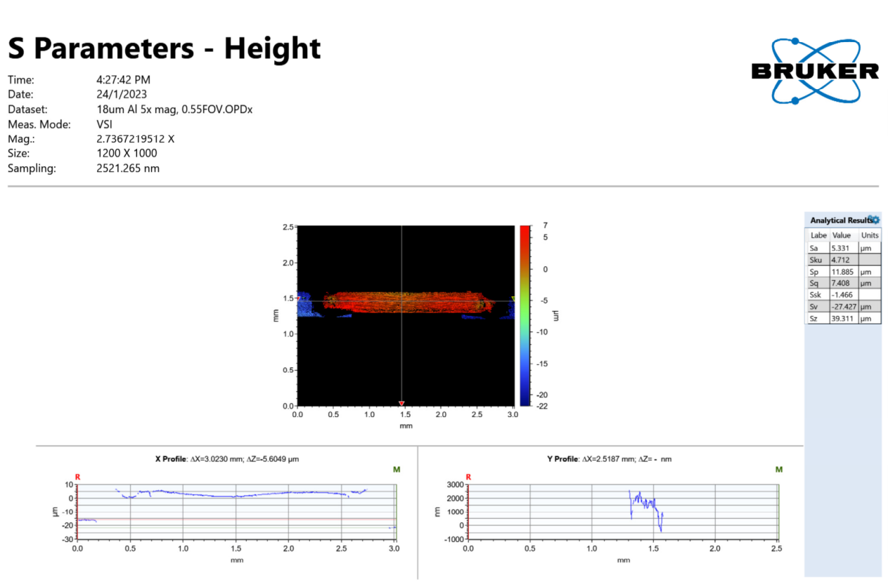
Input data

Slide 4
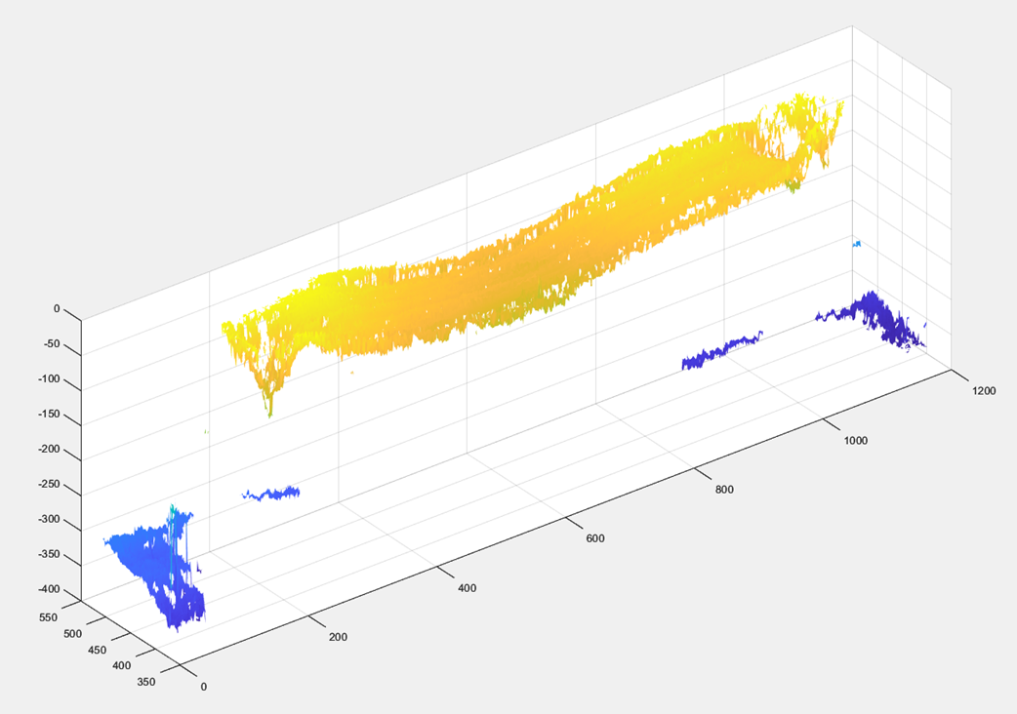
MATLAB Plot

Slide 5
The Algorithm
Searches the middle third (horizontally) of the foil
Finds the n data columns wide section that minimises a certain warp indicator
n depends on the entered approximate beam size in microns
The warp indicator can either be the max range of the data column or the gradient of its best fit line

Slide 6
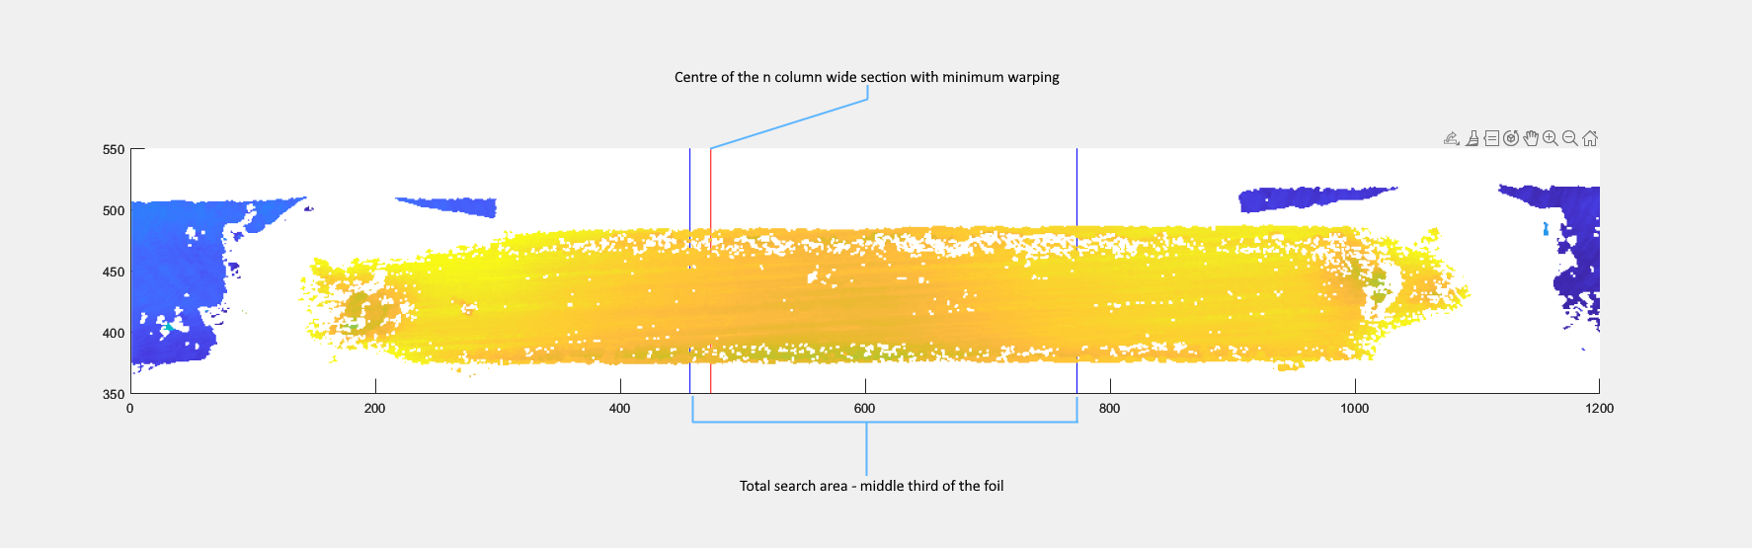
Result

Slide 7
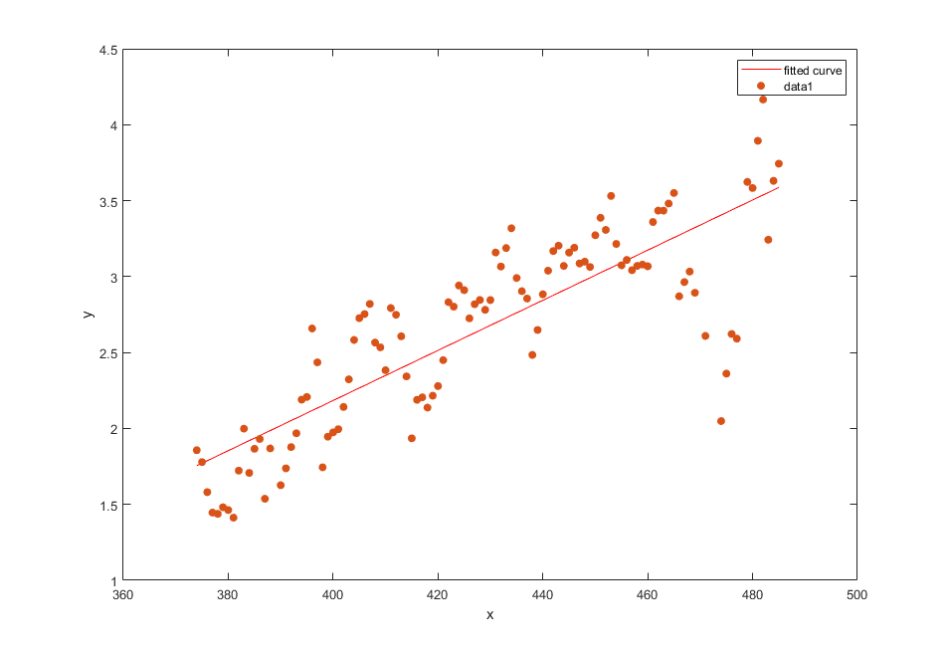
Result

Slide 8
Notes on the Algorithm
Very easy to switch between the two warp indicators (range and best fit gradient)
Can relatively easily add new warp indicators
Currently the stability / flatness in x-direction is not taken account of
Could implement 3D surface fitting if required
This algorithm only requires relative height data to determine the least warped location

Slide 9
MATLAB Plot Caveats
Vertical scale data gets corrupted in the transfer from .OPD to MATLAB array
Change seems to be both translation and scale
Seems dependent on the scan settings
Can be easily corrected in MATLAB, but care must be taken to verify the correction each time
This can be done if absolute values are required for analysis – otherwise the relative height values are sufficient

Slide 10
Obtaining the code
The code for this project is available on GitHub at https://github.com/10Electra/Borghesi-Horizontal-Laser-Positioning
There is detailed explanation, and an ‘issues’ page where you can submit bugs and problems
The repository can either be cloned, or you can simply download the .zip file

Slide 11
Help
Let me know if you need any assistance or if you have any questions!

